Slide 1
Access 2016 Module 10
Creating Advanced Queries

Slide 2
Module Objectives
Query for top values
Create a parameter query
Modify query properties
Create a Make Table query
Create an Append query
Create a Delete query
Create an Update query
Specify join properties
Find unmatched records

Slide 3
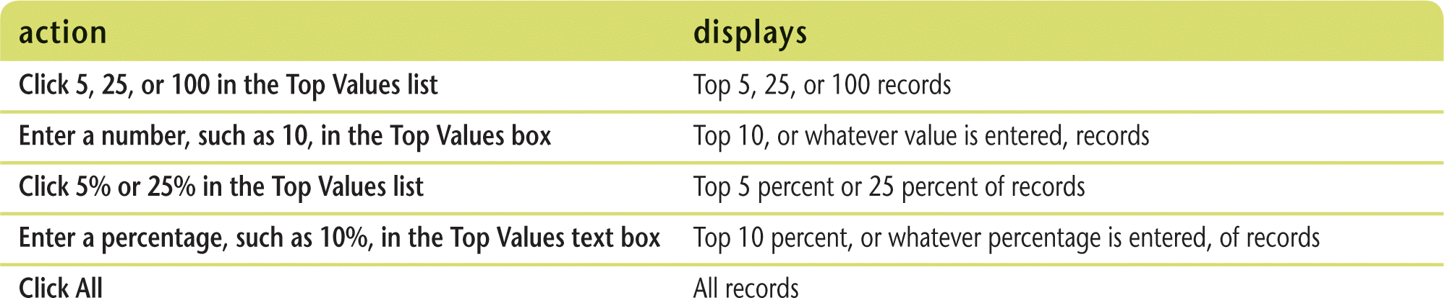
Query for Top Values (Slide 1 of 2)
Top Values feature
Specify a number or percentage of sorted records that you want to display in the query’s datasheet
Records must be sorted in either ascending or descending order
Top Values options

Slide 4
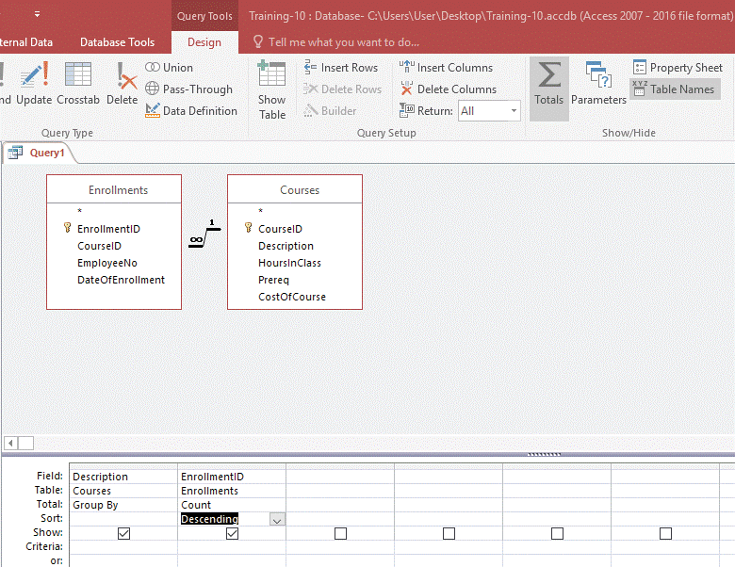
Query for Top Values (Slide 2 of 2)
Designing a summary query for top values

Slide 5
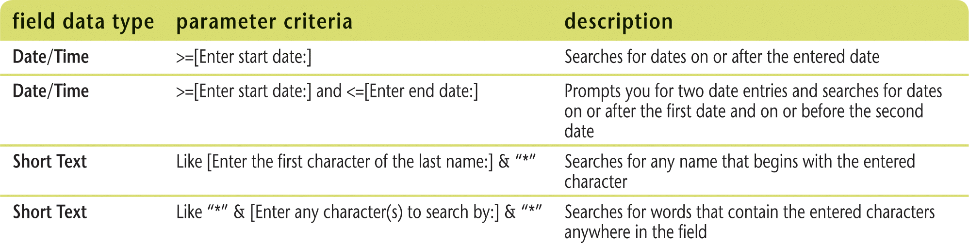
Create a Parameter Query (Slide 1 of 2)
Parameter query
Displays a dialog box
Enter criteria within [square brackets]; appears as a prompt
Selects records based on user entry for field criteria
Can provide the data for a form or report
Examples of parameter criteria

Slide 6
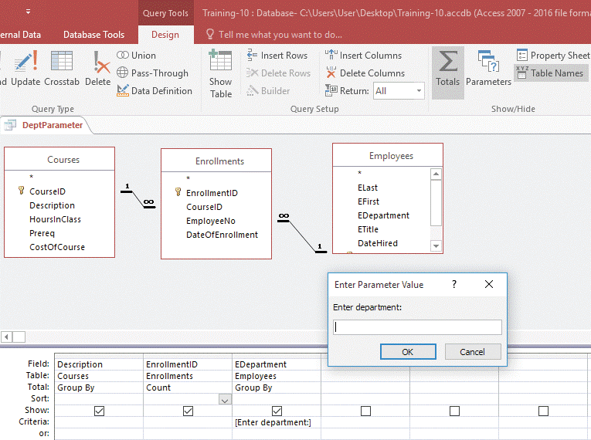
Create a Parameter Query (Slide 2 of 2)
Using parameter criteria for the EDepartment field

Slide 7
Modify Query Properties (Slide 1 of 3)
Properties
define the appearance and behavior of items in the database, e.g., objects, fields, sections, and controls
Query properties include
Recordset Type (determines if records in a query result are locked)
Snapshot (locks)
Dynaset (default, allows updates)
Field properties
describe a field
Caption (changes a field name)
Change in either Table Design View or Query Design View

Slide 8
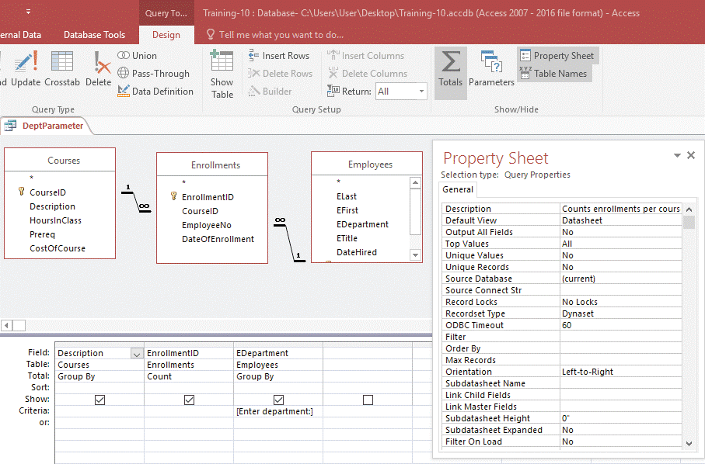
Modify Query Properties (Slide 2 of 3)
Query Property Sheet

Slide 9
Modify Query Properties (Slide 3 of 3)
Creating an Alias
Alias property
renames a field list in Query Design View
Doesn’t change actual name of underlying object
Right-click the field list in Query Design View, click Properties on the shortcut menu, and then modify the Alias property

Slide 10
Create a Make Table Query (Slide 1 of 3)
Action query
changes all of the selected records when it is run
Four types of action queries
Delete
Update
Append
Make Table
Make Table query
creates a new table of data for the selected datasheet

Slide 11
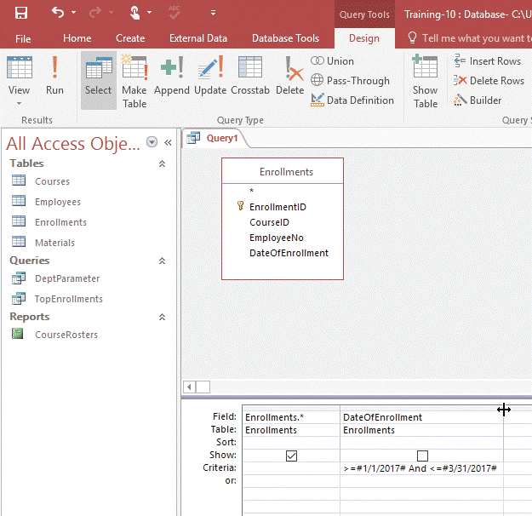
Create a Make Table Query (Slide 2 of 3)
Creating a Make Table query

Slide 12
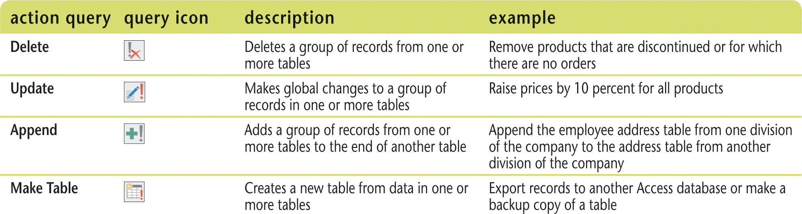
Create a Make Table Query (Slide 3 of 3)
Action queries

Slide 13
Create an Append Query (Slide 1 of 2)
Append query
adds selected records to an existing table (target table)
Append query
works like an export feature
Copies the records from one location and pastes a duplicate set to the target table, which can be in the current database or in any other Access database
1900 versus 2000 dates
How two-digit dates are handled in Access
00 through 29: years 2000 through 2029
30 through 99: years 1930 through 1999

Slide 14
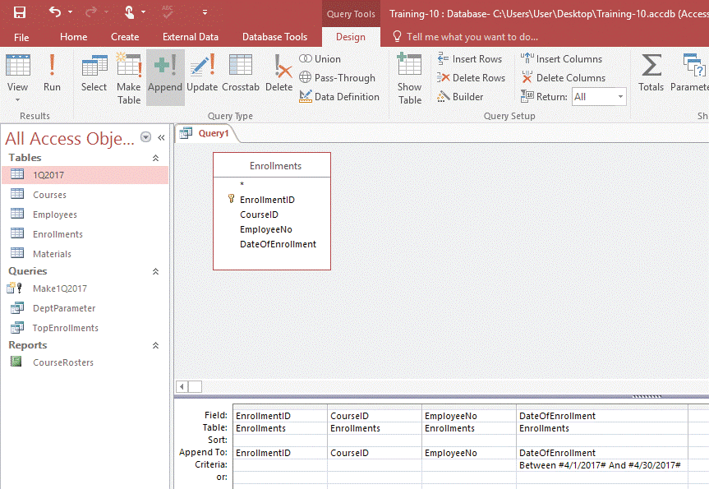
Create an Append Query (Slide 2 of 2)
Creating an Append query

Slide 15
Create a Delete Query (Slide 1 of 2)
Delete query
Deletes a group of records from one or more tables
Deletes entire records, not just selected fields within records
Cannot reverse the action

Slide 16
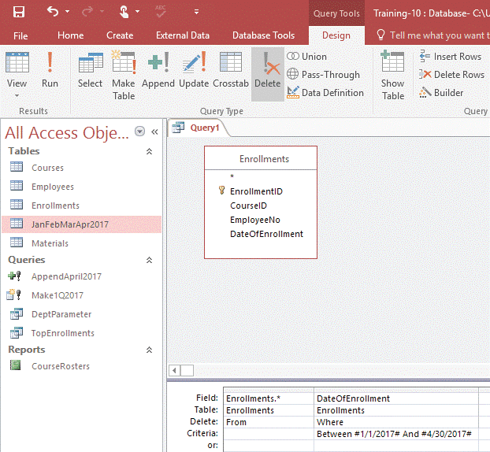
Create a Delete Query (Slide 2 of 2)
Creating a Delete query

Slide 17
Create an Update Query (Slide 1 of 2)
Update query
Updates the values in a field
Hidden property
Use to keep an action query in the Navigation Pane but hide it
To restore hidden property
Right-click a blank spot in Navigation Pane, choose Navigation Options
In Navigation Options dialog box, check Show Hidden Objects check box, click OK

Slide 18
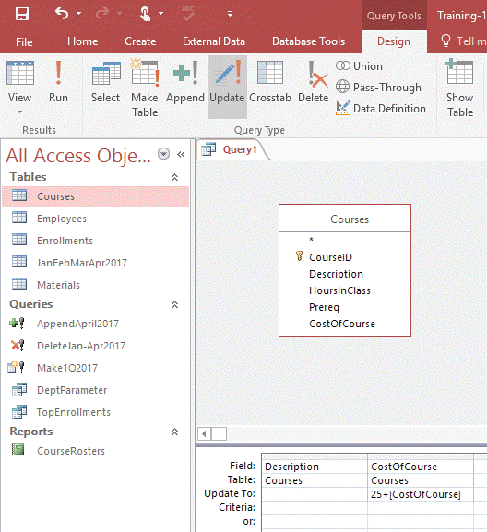
Create an Update Query (Slide 2 of 2)
Setting up an Update query

Slide 19
Specify Join Properties (Slide 1 of 3)
Join lines
Link fields with the same name and data type
Automatically created in Query Design View if no relationships established in the Relationships window
Edit table relationships for a query in Query Design View
Double-click the join line to open the Join Properties dialog box
Left join
All records in the one table even if there are no matching records in the many table
Right join
All records in the many table even if there are no matching records in the one table

Slide 20
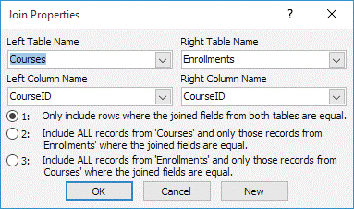
Specify Join Properties (Slide 2 of 3)
Join Properties dialog box
Left join
Right join

Slide 21
Specify Join Properties (Slide 3 of 3)
Null
A field value that does not exist because it has never been entered
Zero-length string
Deliberate entry that contains no characters
Null and zero-length string values, criterion for queries
Zero-length string values
Enter two quotation marks (“”)
Null values
Enter “Is Null”
Value other than a null value
Enter “Is Not Null”

Slide 22
Find Unmatched Records (Slide 1 of 3)
Find Unmatched Query Wizard
Creates an outer join between the tables in the query
Selects all records in one table even if there is no match in the other table
Find Duplicates Query Wizard
Find duplicate values in a field
Can assist in finding and correcting potential data entry errors

Slide 23
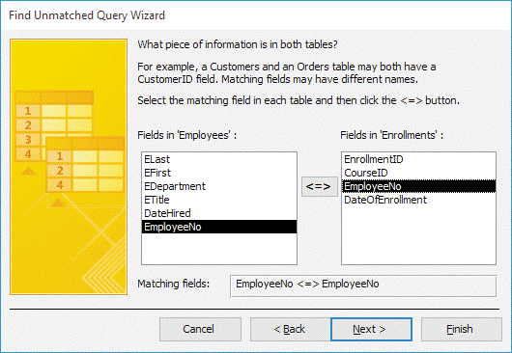
Find Unmatched Records (Slide 2 of 3)
Using the Find Unmatched Query Wizard

Slide 24
Find Unmatched Records (Slide 3 of 3)
Reviewing referential integrity
Established in the Relationships window
Applies a set of rules to the relationship
ensures that no orphaned records currently exist, are added to, or are created in the database
Orphan record: “many” table’s foreign key field entry doesn’t have a matching entry in the “one” table’s primary key field
“One” table (parent records)
“Many” table (child records)
Delete query
not allowed to create orphans

